Slide 1
Chapter 4: Data Warehousing and On-line Analytical Processing
Data Warehouse: Basic Concepts
Data Warehouse Modeling: Data Cube and OLAP
Data Warehouse Design and Usage
Data Warehouse Implementation
Summary

Slide 2
What is a Data Warehouse?
Defined in many different ways, but not rigorously
A decision support database that is maintained separately from the organization’s operational database
Support information processing by providing a solid platform of consolidated, historical data for analysis
“A data warehouse is a subject-oriented, integrated, time-variant, and nonvolatile collection of data in support of management’s decision-making process.”—William H. Inmon
Data warehousing:
The process of constructing and using data warehouses
Data mining tools often access data warehouses rather than operational data.

Slide 3
Data Warehouse—Subject-Oriented
Organized around major subjects, such as customer, product, sales
Focusing on the modeling and analysis of data for decision makers, not on daily operations or transaction processing of an organization
Provide a simple and concise view around particular subject issues by excluding data that are not useful in the decision support process

Slide 4
Data Warehouse—Integrated
Constructed by integrating multiple, heterogeneous data sources
relational databases, flat files, on-line transaction records
Data cleaning and data integration techniques are applied
ensure consistency in naming conventions, encoding structures, attribute measures, etc. among different data sources
Ex. Hotel price: differences on currency, tax, breakfast covered, and parking
When data is moved to the warehouse, it is converted

Slide 5
Data Warehouse—Time Variant
The time horizon for the data warehouse is significantly longer than that of operational systems
Operational data: current (day-to-day) data
Data warehouse data: provide information from a historical perspective (e.g., past 5-10 years)
Every key structure in the data warehouse
Contains an element of time, explicitly or implicitly
But the key of operational data may or may not contain “time element”

Slide 6
Data Warehouse—Nonvolatile
Independence
A physically separate store of data transformed from the application data found in the operational environment
Static: Operational update of data does not occur in the data warehouse environment
Does not require transaction processing, recovery, and concurrency control mechanisms
Requires only two operations in data accessing:
initial loading of data and access of data

Slide 7
Data Warehouse vs. Heterogeneous DBMS
Heterogeneous database: Query driven approach
Traditional database approach to heterogeneous DB integration is to build wrappers and integrators (mediators) on top of heterogeneous databases
When a query is posed to a client site, a meta-dictionary is used to translate the query into queries appropriate for individual heterogeneous sites involved, queries are then mapped and sent to local query processors and the results returned from the different sites are integrated into a global answer set.
Requires complex information filtering and integration process and compete with local sites for processing resources

Slide 8
Data Warehouse vs. Heterogeneous DBMS
Data warehouse: update-driven, high performance
Information from multiple, heterogeneous sources is integrated in advance and stored in warehouses for direct query and analysis
A data warehouse brings high performance to the integrated heterogeneous database system because data are copied, preprocessed, integrated, annotated, summarized, and restructured into one semantic data store.
Query processing in data warehouses does not interfere with the processing at local sources.
Moreover, data warehouses can store and integrate historic information and support complex multidimensional queries.

Slide 9
Data Warehouse vs. Operational DBMS
Operational Database System, OLTP (On-line transaction processing) system
The major task of online operational database systems is to perform online transaction and query processing
Covers most of the day-to-day operations of an organization such as purchasing, inventory, banking, manufacturing, payroll, registration, accounting, etc.
Data Warehouse, OLAP (On-line analytical processing) system
Serve users or knowledge workers ( e.g., managers, analysts, and executives) in the role of data analysis and decision making
Major task of data warehouse system (drilling, slicing, dicing, pivoting etc.)
Organize and present data in various formats in order to accommodate the diverse needs of different users

Slide 10
Data Warehouse vs. Operational DBMS
The major distinguishing features of OLTP and OLAP are summarized as follows:
Users and system orientation: An OLTP system is customer-oriented and is used for transaction and query processing by clerks, clients, and information technology professionals. An OLAP system is market-oriented and is used for data analysis by knowledge workers, including managers, executives, and analysts.
Data contents: An OLTP system manages current data that, typically, are too detailed to be easily used for decision making. An OLAP system manages large amounts of historic data, provides facilities for summarization and aggregation, and stores and manages information at different levels of granularity. These features make the data easier to use for informed decision making.
Database design: An OLTP system usually adopts an entity-relationship (ER) data model and an application-oriented database design. An OLAP system typically adopts either a star or a snowflake model and a subject-oriented database design.

Slide 11
Data Warehouse vs. Operational DBMS
View: An OLTP system focuses mainly on the current data within an enterprise or department, without referring to historic data or data in different organizations. In contrast, an OLAP system often spans multiple versions of a database schema, due to the evolutionary process of an organization. OLAP systems also deal with information that originates from different organizations, integrating information from many data stores. Because of their huge volume, OLAP data are stored on multiple storage media.
Access patterns: The access patterns of an OLTP system consist mainly of short, atomic transactions. Such a system requires concurrency control and recovery mechanisms. However, accesses to OLAP systems are mostly read-only operations (because most data warehouses store historic rather than up-to-date information), although many could be complex queries.
Other features that distinguish between OLTP and OLAP systems include database size, frequency of operations, and performance metrics.

Slide 12
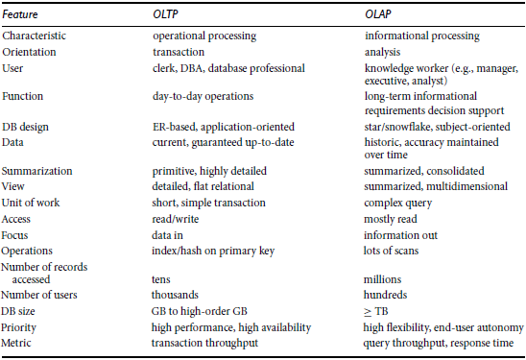
Comparison of OLTP and OLAP System

Slide 13
Why a Separate Data Warehouse?
High performance for both systems
DBMS— tuned for OLTP: access methods, indexing, concurrency control, recovery
Warehouse—tuned for OLAP: complex OLAP queries, multidimensional view, consolidation
Different functions and different data:
missing data: Decision support requires historical data which operational DBs do not typically maintain
data consolidation: DS requires consolidation (aggregation, summarization) of data from heterogeneous sources
data quality: different sources typically use inconsistent data representations, codes and formats which have to be reconciled
Note: There are more and more systems which perform OLAP analysis directly on relational databases

Slide 14
Data Warehouse: A Multi-Tiered Architecture
Top Tier: Front-End Tools
Middle Tier: OLAP Server
Bottom Tier: Data Warehouse Server
Data

Slide 15
Data Warehouse Models
From the architecture point of view, there are three data warehouse models:
Enterprise warehouse
An enterprise warehouse collects all of the information about subjects spanning the entire organization.
It provides corporate-wide data integration, usually from one or more operational systems or external information providers, and is cross-functional in scope.
It typically contains detailed data as well as summarized data, and can range in size from a few gigabytes to hundreds of gigabytes, terabytes, or beyond.
An enterprise data warehouse may be implemented on traditional mainframes, computer superservers, or parallel architecture platforms.
It requires extensive business modeling and may take years to design and build.

Slide 16
Data Warehouse Models
Data Mart
Data mart contains a subset of corporate-wide data that is of value to a specific group of users. The scope is confined to specific selected subjects. For example, a marketing data mart may confine its subjects to customer, item, and sales. The data contained in data marts tend to be summarized.
Data marts are usually implemented on low-cost departmental servers that are Unix/Linux or Windows based.
The implementation cycle of a data mart is more likely to be measured in weeks rather than months or years.
However, it may involve complex integration in the long run if its design and planning were not enterprise-wide.
Depending on the source of data, data marts can be categorized as independent or dependent.

Slide 17
Data Warehouse Models
Independent data marts are sourced from data captured from one or more operational systems or external information providers, or from data generated locally within a particular department or geographic area.
Dependent data marts are sourced directly from enterprise data warehouses.
Virtual warehouse
A set of views over operational databases
For efficient query processing, only some of the possible summary views may be materialized.
A virtual warehouse is easy to build but requires excess capacity on operational database servers.

Slide 18
Extraction, Transformation, and Loading (ETL)
Data warehouse systems use back-end tools and utilities to populate and refresh their data. These tools and utilities include the following functions:
Data extraction, which typically gathers data from multiple, heterogeneous, and external sources.
Data cleaning, which detects errors in the data and rectifies them when possible.
Data transformation, which converts data from legacy or host format to warehouse format.
Load, which sorts, summarizes, consolidates, computes views, checks integrity, and builds indices and partitions.
Refresh, which propagates the updates from the data sources to the warehouse.
Besides cleaning, loading, refreshing, and metadata definition tools, data warehouse systems usually provide a good set of data warehouse management tools.
Notes:
MK 08.11.09 Former title: Data Warehouse Back-End Tools and Utilities

Slide 19
Metadata Repository
Metadata are data about data. When used in a data warehouse, metadata are the data that define warehouse objects. A metadata repository should contain the following:
A description of the data warehouse structure, which includes the warehouse schema, view, dimensions, hierarchies, and derived data definitions, as well as data mart locations and contents.
Operational metadata, which include data lineage (history of migrated data and the sequence of transformations applied to it), currency of data (active, archived, or purged), and monitoring information (warehouse usage statistics, error reports, and audit trails).
The algorithms used for summarization, which include measure and dimension definition algorithms, data on granularity, partitions, subject areas, aggregation, summarization, and predefined queries and reports.

Slide 20
Metadata Repository
Mapping from the operational environment to the data warehouse, which includes source databases and their contents, gateway descriptions, data partitions, data extraction, cleaning, transformation rules and defaults, data refresh and purging rules, and security (user authorization and access control).
Data related to system performance, which include indices and profiles that improve data access and retrieval performance, in addition to rules for the timing and scheduling of refresh, update, and replication cycles.
Business metadata, which include business terms and definitions, data ownership information, and charging policies.

Slide 21
Chapter 4: Data Warehousing and On-line Analytical Processing
Data Warehouse: Basic Concepts
Data Warehouse Modeling: Data Cube and OLAP
Data Warehouse Design and Usage
Data Warehouse Implementation
Summary

Slide 22
From Tables and Spreadsheets to Data Cubes
A data warehouse is based on a multidimensional data model which views data in the form of a data cube. It is defined by dimensions and facts.
Dimensions are the perspectives or entities with respect to which an organization wants to keep records.
For example, An organization may create a sales data warehouse in order to keep records of the store’s sales with respect to the dimensions time, item, branch, and location. These dimensions allow the store to keep track of things like monthly sales of items and the branches and locations at which the items were sold.
Each dimension may have a table associated with it, called a dimension table, which further describes the dimension.
For example, a dimension table for item may contain the attributes item name, brand, and type.
Dimension tables can be specified by users or experts, or automatically generated and adjusted based on data distributions.

Slide 23
From Tables and Spreadsheets to Data Cubes
A data cube, such as sales, allows data to be modeled and viewed in multiple dimensions.
Dimension tables, such as item (item_name, brand, type), or time(day, week, month, quarter, year)
Fact table contains measures (such as dollars_sold) and keys to each of the related dimension tables
Data cube: A lattice of cuboids
In data warehousing literature, an n-D base cube is called a base cuboid
The top most 0-D cuboid, which holds the highest-level of summarization, is called the apex cuboid
The lattice of cuboids forms a data cube.

Slide 24
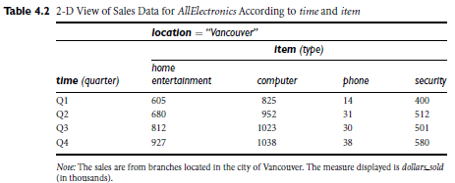
From Tables and Spreadsheets to Data Cubes

Slide 25
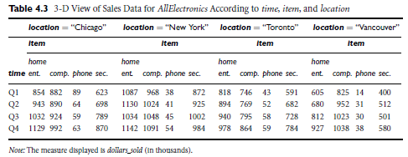
From Tables and Spreadsheets to Data Cubes

Slide 26
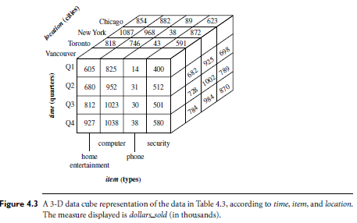
From Tables and Spreadsheets to Data Cubes

Slide 27
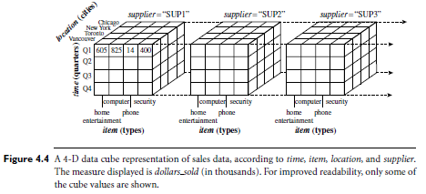
From Tables and Spreadsheets to Data Cubes

Slide 28



Data Cube: A Lattice of Cuboids
all
0-D (apex) cuboid
time
item
location
supplier
1-D cuboids
time,location
item,location
location,supplier
2-D cuboids
time,supplier
item,supplier
time,item
time,location,supplier
3-D cuboids
time,item,supplier
item,location,supplier
time,item,location
4-D (base) cuboid
time, item, location, supplier

Slide 29
Schemas for Multidimensional Data Models
A data warehouse requires a concise, subject-oriented schema that facilitates online data analysis.
The most popular data model for a data warehouse is a multidimensional model, which can exist in the form of a star schema, a snowflake schema, or a fact constellation schema.
Star schema: In star schema data warehouse contains
(1) a large central table (fact table) containing the bulk of the data, with no redundancy, and
(2) a set of smaller attendant tables (dimension tables), one for each dimension. The schema graph resembles a starburst, with the dimension tables displayed in a radial pattern around the central fact table.
Moreover, the attributes within a dimension table may form either a hierarchy (total order) or a lattice (partial order).

Slide 30
Star Schema: An Example
time
time_key
day
day_of_the_week
month
quarter
year
item
item_key
item_name
brand
type
supplier_type
Sales Fact Table
time_key
item_key
branch_key
branch
location
location_key
branch_key
branch_name
branch_type
location_key
street
city
state_or_province
country
units_sold
dollars_sold
avg_sales
Measures

Slide 31
Schemas for Multidimensional Data Models
Snowflake schema: The snowflake schema is a variant of the star schema model, where some dimension tables are normalized, thereby further splitting the data into additional tables. The resulting schema graph forms a shape similar to a snowflake.
The major difference between the snowflake and star schema models is that the dimension tables of the snowflake model may be kept in normalized form to reduce redundancies. Such a table is easy to maintain and saves storage space.
However, this space savings is negligible in comparison to the typical magnitude of the fact table. Furthermore, the snowflake structure can reduce the effectiveness of browsing, since more joins will be needed to execute a query. Consequently, the system performance may be adversely impacted.
Hence, although the snowflake schema reduces redundancy, it is not as popular as the star schema in data warehouse design.

Slide 32
Snowflake Schema: An Example
time
item
time_key
day
day_of_the_week
month
quarter
year
item_key
item_name
brand
type
supplier_key
supplier
Sales Fact Table
supplier_key
supplier_type
time_key
item_key
branch_key
branch
location
location_key
location_key
street
city_key
branch_key
branch_name
branch_type
units_sold
dollars_sold
city
city_key
city
state_or_province
country
avg_sales
Measures

Slide 33
Schemas for Multidimensional Data Models
Fact constellation: Sophisticated applications may require multiple fact tables to share dimension tables.
A fact constellation schema allows dimension tables to be shared between fact tables. For example, the dimensions tables for time, item, and location are shared between the sales and shipping fact tables.
This kind of schema can be viewed as a collection of stars, and hence is called a galaxy schema or a fact constellation.

Slide 34
Fact Constellation: An Example
time
time_key
day
day_of_the_week
month
quarter
year
item
Shipping Fact Table
item_key
item_name
brand
type
supplier_type
Sales Fact Table
time_key
time_key
item_key
shipper_key
item_key
branch_key
from_location
branch
location_key
location
to_location
branch_key
branch_name
branch_type
units_sold
location_key
street
city
province_or_state
country
dollars_cost
dollars_sold
units_shipped
avg_sales
shipper
Measures
shipper_key
shipper_name
location_key
shipper_type

Slide 35
Warehouse Model Vs. Schema
In data warehousing, there is a distinction between a data warehouse and a data mart.
A data warehouse collects information about subjects that span the entire organization, such as customers, items, sales, assets, and personnel, and thus its scope is enterprise-wide.
For data warehouses, the fact constellation schema is commonly used, since it can model multiple, interrelated subjects.
A data mart, on the other hand, is a department subset of the data warehouse that focuses on selected subjects, and thus its scope is department-wide.
For data marts, the star or snowflake schema is commonly used, since both are geared toward modeling single subjects, although the star schema is more popular and efficient.

Slide 36
Concept Hierarchies
A concept hierarchy defines a sequence of mappings from a set of low-level concepts to higher-level, more general concepts. Concept hierarchies allow data to be handled at varying levels of abstraction.
A concept hierarchy may have total or partial order among attributes:
Total: location, partial: time (forms lattice)
Concept hierarchies may also be defined by discretizing or grouping values for a given dimension or attribute, resulting in a set-grouping hierarchy.
There may be more than one concept hierarchy for a given attribute or dimension, based on different user viewpoints. For instance, a user may prefer to organize price by defining ranges for inexpensive, moderately priced, and expensive.
Concept hierarchies may be provided manually by system users, domain experts, or knowledge engineers, or may be automatically generated based on statistical analysis of the data distribution.

Slide 37
A Concept Hierarchy for a Dimension (location)
all
all
region
Europe
...
North_America
country
Germany
...
Spain
Canada
...
Mexico
city
Frankfurt
...
Vancouver
...
Toronto
office
L. Chan
...
M. Wind

Slide 38
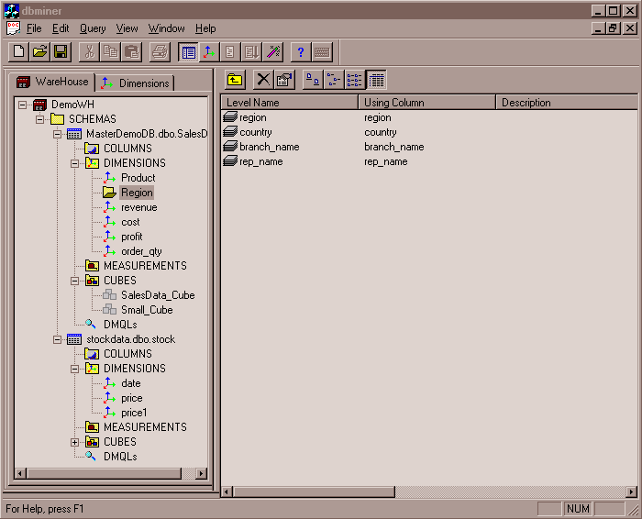
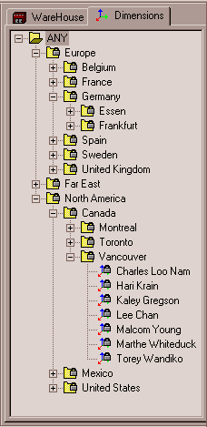
View of Warehouses and Hierarchies
Specification of hierarchies
Schema hierarchy
day < {month < quarter; week} < year
Set_grouping hierarchy
{1..10} < inexpensive

Slide 39
Data Cube Measures: Three Categories
Measures can be organized into three categories—distributive, algebraic, and holistic— based on the kind of aggregate functions used.
Distributive: if the result derived by applying the function to n aggregate values is the same as that derived by applying the function on all the data without partitioning
E.g., count(), sum(), min(), max()
Algebraic: if it can be computed by an algebraic function with M arguments (where M is a bounded integer), each of which is obtained by applying a distributive aggregate function
avg(x) = sum(x) / count(x), where both sum() and count() are distributive aggregate functions. Is min_N(), max_N are algebraic measures? How about standard_deviation()?
Holistic: if there is no constant bound on the storage size needed to describe a sub-aggregate.
E.g., median(), mode(), rank()

Slide 40
Multidimensional Data
Sales volume as a function of product, month, and region
Dimensions: Product, Location, Time
Hierarchical summarization paths
Region
Industry Region Year
Category Country Quarter
Product City Month Week
Office Day
Product
Month

Slide 41
A Sample Data Cube
Date
Total annual sales
of TVs in U.S.A.
1Qtr
2Qtr
3Qtr
4Qtr
sum
Product
TV
PC
U.S.A
VCR
sum
Canada
Country
Mexico
sum
All, All, All

Slide 42
Cuboids Corresponding to the Cube
all
0-D (apex) cuboid
product
date
country
1-D cuboids
product,date
product,country
date, country
2-D cuboids
3-D (base) cuboid
product, date, country

Slide 43
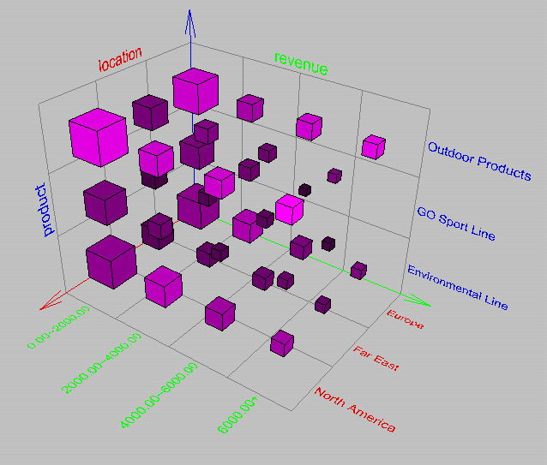
Browsing a Data Cube
Visualization
OLAP capabilities
Interactive manipulation

Slide 44
Typical OLAP Operations
Roll-up (drill-up): summarize data
The roll-up operation (also called the drill-up ) performs aggregation on a data cube, either by climbing up a concept hierarchy for a dimension or by dimension reduction.
When roll-up is performed by dimension reduction, one or more dimensions are removed from the given cube.
Drill-down (roll-down): reverse of roll-up
It navigates from less detailed data to more detailed data. Drill-down can be realized by either stepping down a concept hierarchy for a dimension or introducing additional dimensions
Because a drill-down adds more detail to the given data, it can also be performed by adding new dimensions to a cube. For example, a drill-down on the central cube can occur by introducing an additional dimension, such as customer group.

Slide 45
Typical OLAP Operations
Slice and dice: The slice operation performs a selection on one dimension of the given cube, resulting in a subcube. The dice operation defines a subcube by performing a selection on two or more dimensions.
Pivot (rotate): Pivot (also called rotate) is a visualization operation that rotates the data axes in view to provide an alternative data presentation.
Examples: rotating the axes in a 3-D cube, or transforming a 3-D cube into a series of 2-D planes.
Other operations
Drill across: execute queries involving (across) more than one fact table
Drill through: operation uses relational SQL facilities to drill through the bottom level of a data cube down to its back-end relational tables.
Other OLAP operations may include ranking the top N or bottom N items in lists, as well as computing moving averages, growth rates, interests, internal return rates, depreciation, currency conversions, and statistical functions.

Slide 46
Typical OLAP Operations

Slide 47
A Star-Net Query Model for Multidimensional Model
The querying of multidimensional databases can be based on a starnet model
consists of radial lines emanating from a central point, where each line represents a concept hierarchy for a dimension.
Each abstraction level in the hierarchy is called a footprint. These represent the granularities available for use by OLAP operations such as drill-down and roll-up.
Concept hierarchies can be used to generalize data by replacing low-level values (such as “day” for the time dimension) by higher-level abstractions (such as “year”), or to specialize data by replacing higher-level abstractions with lower-level values.

Slide 48
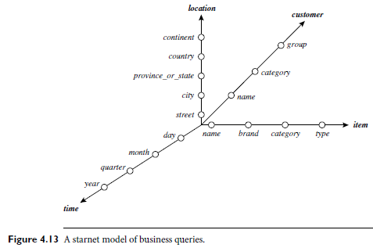
A Star-Net Query Model

Slide 49
A Star-Net Query Model
Customer Orders
Shipping Method
Customer
CONTRACTS
AIR-EXPRESS
ORDER
TRUCK
PRODUCT LINE
Time
Product
ANNUALY
QTRLY
DAILY
PRODUCT ITEM
PRODUCT GROUP
CITY
SALES PERSON
COUNTRY
DISTRICT
REGION
DIVISION
Location
Each circle is called a footprint
Promotion
Organization

Slide 50
Chapter 4: Data Warehousing and On-line Analytical Processing
Data Warehouse: Basic Concepts
Data Warehouse Modeling: Data Cube and OLAP
Data Warehouse Design and Usage
Data Warehouse Implementation
Summary

Slide 51
Design of Data Warehouse: A Business Analysis Framework
“What can business analysts gain from having a data warehouse?”
First, having a data warehouse may provide a competitive advantage by presenting relevant information from which to measure performance and make critical adjustments to help win over competitors.
Second, a data warehouse can enhance business productivity because it is able to quickly and efficiently gather information that accurately describes the organization.
Third, a data warehouse facilitates customer relationship management (CRM) because it provides a consistent view of customers and items across all lines of business, all departments, and all markets.
Finally, a data warehouse may bring about cost reduction by tracking trends, patterns, and exceptions over long periods in a consistent and reliable manner.

Slide 52
Design of Data Warehouse: A Business Analysis Framework
Four views regarding a data warehouse design must be considered:
Top-down view
Data source view
Data warehouse view
Business query view
Top-down view
allows selection of the relevant information necessary for the data warehouse. It matches the current and future business needs.
Data source view
This view exposes the information being captured, stored, and managed by operational systems.

Slide 53
Design of Data Warehouse: A Business Analysis Framework
Usually modeled by traditional data modeling techniques, such as ER model or CASE (computer-aided software engineering) tools.
Data warehouse view
This view consists of fact tables and dimension tables.
It represents the information that is stored inside the data warehouse, including pre-calculated totals and counts, as well as information regarding the source, date, and time of origin, added to provide historical context.
Business query view
It is the data perspective in the data warehouse from the end-user’s viewpoint.

Slide 54
Data Warehouse Design Process
Built using top-down approach, bottom-up approach or a combination of both.
Top-down: Starts with overall design and planning (mature)
Bottom-up: Starts with experiments and prototypes (rapid)
Combined exploit the planned and strategic nature of the top-down approach while retaining the rapid implementation and opportunistic application of the bottom-up approach
From software engineering point of view
Waterfall: structured and systematic analysis at each step before proceeding to the next
Spiral: rapid generation of increasingly functional systems, with short intervals between successive releases. This is considered a good choice for data warehouse development, especially for data marts, because the turnaround time is short, modifications can be done quickly, and new designs and technologies can be adapted in a timely manner.

Slide 55
Data Warehouse Design Process
Typical data warehouse design process
1. Choose a business process to model (e.g., orders, invoices, shipments, inventory, account administration, sales, or the general ledger) .
If the business process is organizational and involves multiple complex object collections, a data warehouse model should be followed.
However, if the process is departmental and focuses on the analysis of one kind of business process, a data mart model should be chosen.
2. Choose the business process grain, which is the fundamental, atomic level of data to be represented in the fact table for this process (e.g., individual transactions, individual daily snapshots, and so on).
3. Choose the dimensions that will apply to each fact table record. Typical dimen-sions are time, item, customer, supplier, warehouse, transaction type, and status.
4. Choose the measures that will populate each fact table record. Typical measures are numeric additive quantities like dollars sold and units sold.

Slide 56
Data Warehouse Usage
Three kinds of data warehouse applications
Information processing
supports querying, basic statistical analysis, and reporting using crosstabs, tables, charts and graphs.
current trend is to construct low-cost web-based accessing tools that are then integrated with web browsers.
Analytical processing
supports basic OLAP operations, including slice-and-dice, drill-down, roll-up, and pivoting.
generally operates on historic data in both summarized and detailed forms.
The major strength of online analytical processing over information processing is the multidimensional data analysis of data warehouse data.

Slide 57
Data Warehouse Usage
Data mining
Supports knowledge discovery from hidden patterns
Also supports associations, constructing analytical models, performing classification and prediction, and presenting the mining results using visualization tools

Slide 58
From On-Line Analytical Processing (OLAP) to On Line Analytical Mining (OLAM)
The data mining field has conducted substantial research regarding mining on various data types, including relational data, data from data warehouses, transaction data, time-series data, spatial data, text data, and flat files.
Multidimensional data mining (also known as exploratory multidimensional data mining, online analytical mining, or OLAM) integrates OLAP with data mining to uncover knowledge in multidimensional databases.
Multidimensional data mining is particularly important for the following reasons:
High quality of data in data warehouses:
Most data mining tools need to work on integrated, consistent, and cleaned data, which requires costly data cleaning, data integration, and data transformation as preprocessing steps.
A data warehouse constructed by such preprocessing serves as a valuable source of high-quality data for OLAP as well as for data mining.

Slide 59
From On-Line Analytical Processing (OLAP) to On Line Analytical Mining (OLAM)
Available information processing structure surrounding data warehouses
Includes accessing, integration, consolidation, and transformation of multiple heterogeneous databases, ODBC/OLEDB connections, Web accessing and service facilities, and reporting and OLAP analysis tools.
It is prudent to make the best use of the available infrastructures rather than constructing everything from scratch.
OLAP-based exploration of multidimenmsional data
It facilitates to traverse through a database, select portions of relevant data, analyze them at different granularities, and present knowledge/results in different forms.
Multidimensional data mining provides facilities for mining on different subsets of data and at varying levels of abstraction—by drilling, pivoting,

Slide 60
From On-Line Analytical Processing (OLAP) to On Line Analytical Mining (OLAM)
filtering, dicing, and slicing on a data cube and/or intermediate data mining results.
This, together with data/knowledge visualization tools, greatly enhances the power and flexibility of data mining.
On-line selection of data mining functions
By integrating OLAP with various data mining functions, multidimensional data mining provides users with the flexibility to select desired data mining functions and swap data mining tasks dynamically.

Slide 61
Chapter 4: Data Warehousing and On-line Analytical Processing
Data Warehouse: Basic Concepts
Data Warehouse Modeling: Data Cube and OLAP
Data Warehouse Design and Usage
Data Warehouse Implementation
Summary

Slide 62
Data Warehouse Implementation
Data warehouses contain huge volumes of data. OLAP servers demand that decision support queries be answered in the order of seconds.
Therefore, it is crucial for data warehouse systems to support highly efficient cube computation techniques, access methods, and query processing techniques. So, the knowledge of followings are important:
Overview of methods for the efficient implementation of data warehouse systems
Explore how to compute data cubes efficiently
How OLAP data can be indexed, using either bitmap or join indices
How OLAP queries are processed
Finally, various types of warehouse servers for OLAP processing

Slide 63
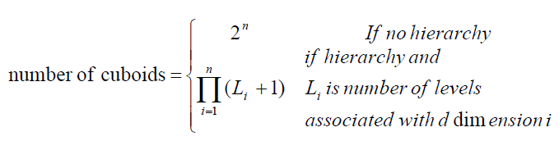
Efficient Data Cube Computation: An Overview
At the core of multidimensional data analysis is the efficient computation of aggregations across many sets of dimensions.
In SQL terms, these aggregations are referred to as group-by’s. Each group-by can be represented by a cuboid, where the set of group-by’s forms a lattice of cuboids defining a data cube.
No. of cuboids:
Why this formula?
Industry Region Year
Category Country Quarter
Product City Month Week
Office Day

Slide 64
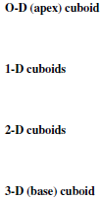
The “Compute Cube” Operator
Cube definition and computation in DMQL
define cube sales_cube [item, city, year]: sum (sales_in_dollars)
compute cube sales_cube
Transform it into a SQL-like language (with a new operator cube by, introduced by Gray et al.’96)
SELECT item, city, year, SUM (amount)
FROM sales_cube
CUBE BY item, city, year
Need compute the following Group-Bys
(item, city, year),
(item, city),(item, year), (city, year),
(item), (city), (year)
()
()
(city)
(item)
(year)
(city, item)
(city, year)
(item, year)
(city, item, year)

Slide 65
Curse of Dimensionality
Online analytical processing may need to access different cuboids for different queries. Therefore, it may seem like a good idea to compute in advance all or at least some of the cuboids in a data cube.
Pre-computation leads to fast response time and avoids some redundant computation. Most, if not all, OLAP products resort to some degree of pre-computation of multidimensional aggregates.
A major challenge related to this pre-computation, however, is that the required storage space may explode if all the cuboids in a data cube are pre-computed, especially when the cube has many dimensions.
The storage requirements are even more excessive when many of the dimensions have associated concept hierarchies, each with multiple levels.
This problem is referred to as the curse of dimensionality.

Slide 66
Why Partial Materialization?
At most, one abstraction level in each dimension will appear in a cuboid.
For example, the time dimension (year < quarter < month < day ) has four conceptual levels, or five if we include the virtual level all.
If the cube has 10 dimensions and each dimension has five levels (including all), the total number of cuboids that can be generated is 5 ∧ 10 ≅ 9.8 x 10 ∧ 6.
The size of each cuboid also depends on the cardinality (i.e., number of distinct values) of each dimension. As the number of dimensions, number of conceptual hierarchies, or cardinality increases, the storage space required for many of the group-by’s will grossly exceed the (fixed) size of the input relation.
So, it is unrealistic to pre-compute and materialize all of the cuboids that can possibly be generated for a data cube (i.e., from a base cuboid).
If there are many large cuboids, a more reasonable option is partial materialization; that is, to materialize only some of the possible cuboids that can be generated.

Slide 67
Partial Materialization: Selected Computation of Cuboids
There are three choices for data cube materialization given a base cuboid:
1. No materialization: Do not pre-compute any of the “non-base” cuboids. This leads to computing expensive multidimensional aggregates on-the-fly, which can be extremely slow.
2. Full materialization: Pre-compute all of the cuboids. The resulting lattice of computed cuboids is referred to as the full cube. This choice typically requires huge amounts of memory space in order to store all of the pre-computed cuboids.
3. Partial materialization: Selectively compute a proper subset of the whole set of possible cuboids. Alternatively, we may compute a subset of the cube, which contains only those cells that satisfy some user-specified criterion, such as where the tuple count of each cell is above some threshold, called subcube, where only some of the cells may be pre-computed for various cuboids.
Partial materialization represents an interesting trade-off between storage space and response time.

Slide 68
Indexing OLAP Data: Bitmap Index
Index on a particular column
Each value in the column has a bit vector: bit-op is fast
The length of the bit vector: # of records in the base table
The i-th bit is set if the i-th row of the base table has the value for the indexed column
not suitable for high cardinality domains
A recent bit compression technique, Word-Aligned Hybrid (WAH), makes it work for high cardinality domain as well [Wu, et al. TODS’06]
Base table
Index on Region
Index on Type
Notes:
Bit-map index compression methods should be introduced -JH

Slide 69
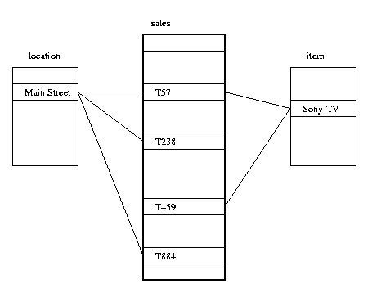
Indexing OLAP Data: Join Indices
Join index: JI(R-id, S-id) where R (R-id, …)  S (S-id, …)
Traditional indices map the values to a list of record ids
It materializes relational join in JI file and speeds up relational join
In data warehouses, join index relates the values of the dimensions of a start schema to rows in the fact table.
E.g., fact table: Sales and two dimensions city and product
A join index on city maintains for each distinct city a list of R-IDs of the tuples recording the Sales in the city
Join indices can span multiple dimensions

Slide 70
Efficient Processing OLAP Queries
The purpose of materializing cuboids and constructing OLAP index structures is to speed up query processing in data cubes. Given materialized views, query processing should proceed as follows:
1. Determine which operations should be performed on the available cuboids: This involves transforming any selection, projection, roll-up (group-by), and drill-down operations specified in the query into corresponding SQL and/or OLAP operations.
For example, slicing and dicing a data cube may correspond to selection and/or projection operations on a materialized cuboid.
2. Determine to which materialized cuboid(s) the relevant operations should be applied: This involves identifying all of the materialized cuboids that may potentially be used to answer the query, pruning the set using knowledge of “dominance” relationships among the cuboids, estimating the costs of using the remaining materialized cuboids, and selecting the cuboid with the least cost.

Slide 71
Efficient Processing OLAP Queries
Example: Suppose that we define a data cube of the form “sales_cube [time, item, location]: sum(sales in dollars).” The dimension hierarchies used are
“day < month < quarter < year” for time;
“item_name < brand < type” for item; and
“street < city < province_or_state < country” for location.
Let the query to be processed be on {brand, province_or_state} with the condition “year = 2004”, and there are 4 materialized cuboids available:
cuboid 1: {year, item_name, city}
cuboid 2: {year, brand, country}
cuboid 3: {year, brand, province_or_state}
cuboid 4: {item_name, province_or_state} where year = 2004
Which cuboid should be selected to process the query? Cuboid 3 or 4?

Slide 72
OLAP Server Architectures
Relational OLAP (ROLAP)
Use relational or extended-relational DBMS to store and manage warehouse data and OLAP middle ware to support missing pieces
Include optimization of DBMS backend, implementation of aggregation navigation logic, and additional tools and services
Greater scalability
Multidimensional OLAP (MOLAP)
Support multidimensional data views through array-based multidimensional storage engines.
They map multidimensional views directly to data cube array structures
Allows fast indexing to pre-computed summarized data

Slide 73
OLAP Server Architectures
Hybrid OLAP (HOLAP) (e.g., Microsoft SQL Server)
Combines ROLAP and MOLAP technology, benefiting from the greater scalability of ROLAP (low level: relational) and the faster computation of MOLAP (high-level: array)
For example, a HOLAP server may allow large volumes of detailed data to be stored in a relational database, while aggregations are kept in a separate MOLAP store.
Specialized SQL Servers (e.g., Redbricks)
To meet the growing demand of OLAP processing in relational databases, some database system vendors implement specialized SQL servers that provide advanced query language and query processing support for SQL queries over star and snowflake schemas in a read-only environment.

Slide 74
Chapter 4: Data Warehousing and On-line Analytical Processing
Data Warehouse: Basic Concepts
Data Warehouse Modeling: Data Cube and OLAP
Data Warehouse Design and Usage
Data Warehouse Implementation
Summary

Slide 75
Summary
Data warehousing: A multi-dimensional model of a data warehouse
A data cube consists of dimensions & measures
Star schema, snowflake schema, fact constellations
OLAP operations: drilling, rolling, slicing, dicing and pivoting
Data Warehouse Architecture, Design, and Usage
Multi-tiered architecture
Business analysis design framework
Information processing, analytical processing, data mining, OLAM
Implementation: Efficient computation of data cubes
Partial vs. full vs. no materialization
Indexing OALP data: Bitmap index and join index
OLAP query processing
OLAP servers: ROLAP, MOLAP, HOLAP

